Slide 1
Employee Data Analysis using Excel
STUDENT NAME: PREETHIKA.V.V
REGISTER NO: 422200901
DEPARTMENT: III B.COM ISM
COLLEGE: SHRI KRISHNASWAMY COLLEGE FOR WOMEN

Slide 2
PROJECT TITLE
VISUALIZING EMPLOYEE ATTENDANCE TRENDS WITH EXCEL CHARTS

Slide 3


AGENDA
Problem Statement
Project Overview
End Users
Our Solution and Proposition
Dataset Description
Modelling Approach
Results and Discussion
Conclusion
3/21/2024 Annual Review

Slide 4

PROBLEM STATEMENT
Enhancing Employee Attendance Analysis Through Effective Visualization Using Excel Charts
The raw attendance data in Excel lacks effective visual representation, leading to difficulties in quickly identifying and interpreting trends, patterns, and anomalies in employee attendance. This hampers our ability to make data-driven decisions regarding attendance management, scheduling, and overall workforce planning. Without clear and actionable visualizations, managers and HR personnel struggle to assess attendance issues and performance efficiently.

Slide 5

PROJECT OVERVIEW
Trend Visualization: Create Excel charts that illustrate attendance trends over time, helping to identify patterns such as seasonal variations, frequent absenteeism, or trends in tardiness.
Comparative Analysis: Develop charts that allow for comparisons across different departments, employee groups, or time periods to assess variations in attendance.
Anomaly Detection: Design visualizations to highlight anomalies, such as spikes in absenteeism or consistent lateness, for proactive management.
Decision Support: Provide user-friendly charts that support decision-making processes by offering a clear view of attendance metrics and performance.

Slide 6

WHO ARE THE END USERS?
1. Human Resources (HR) Manager
2. Department Heads/Team Leaders
3. Payroll Administrators
4. Senior Management/Executives
5. Employee Relations Specialists
6. Data Analysts

Slide 7

OUR SOLUTION AND ITS VALUE PROPOSITION
Solution :
Our solution involves developing a comprehensive set of Excel charts designed to visualize employee attendance trends effectively. This solution leverages Excel’s charting capabilities to provide clear, actionable insights into attendance patterns, enabling better management, strategic decision-making, and proactive intervention. The solution includes various types of charts and interactive elements to cater to different analytical needs and user preferences.
Proposition :
1. Enhanced Data Visibility
2. Improved Decision-Making
3. Proactive Management
4. Streamlined Reporting
5. User-Friendly Interface

Slide 8
Dataset Description
a. Employee Information:
Employee ID: Unique identifier for each employee (e.g., E001, E002).
Employee Name: Full name of the employee (e.g., John Doe).
Department: Department or team to which the employee belongs (e.g., Sales, HR).
b. Attendance Records:
Date: The specific date of the attendance record (e.g., 2024-08-01).
Day of Week: The day of the week for the date (e.g., Monday).
Attendance Status: The status of attendance for that day (e.g., Present, Absent, Late, Leave).
Hoc. Monthly Trends:

Slide 9

THE "WOW" IN OUR SOLUTION
The "wow" factor in our solution for visualizing employee attendance trends with Excel charts lies in its ability to transform complex data into clear, actionable insights through dynamic and interactive visualizations. By combining advanced features with user-friendly design, our solution empowers users to easily explore, understand, and act on attendance data, driving more informed decision-making and enhanced workforce management.
1. Dynamic and Interactive Dashboards
2. Advanced Trend Analysis
3. Comprehensive Comparative Visualizations
4. Interactive Slicers and Filters
3/21/2024 Annual Review
9

Slide 10
MODELLING
1. Define the Data Model
a. Data Structure
b. Key Metrics
2. Prepare and Clean the Data
a. Data Collection
b. Data Cleaning
c. Data Transformation
3. Create Visualizations
a. Line Charts
b. Bar Charts
10

Slide 11
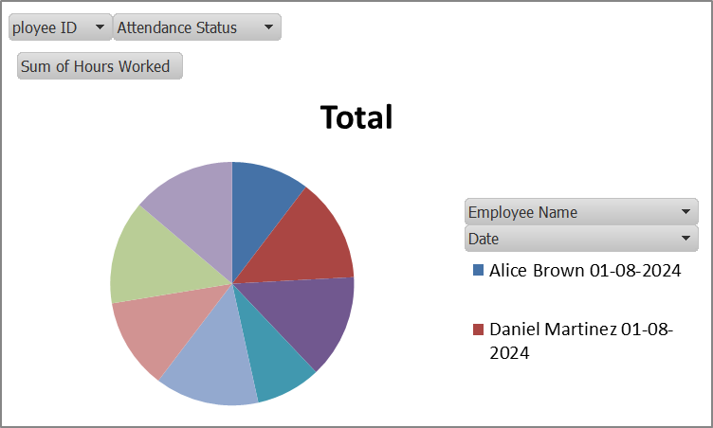
RESULTS
11

Slide 12
conclusion
Visualizing employee attendance trends with Excel charts provides organizations with a powerful tool for managing and optimizing workforce performance. By leveraging Excel’s charting capabilities, organizations can transform raw attendance data into meaningful insights, leading to more informed and strategic decision-making.
This approach ultimately contributes to a more efficient, engaged, and productive workforce, driving organizational success and achieving better outcomes in workforce management.

